Slide 1
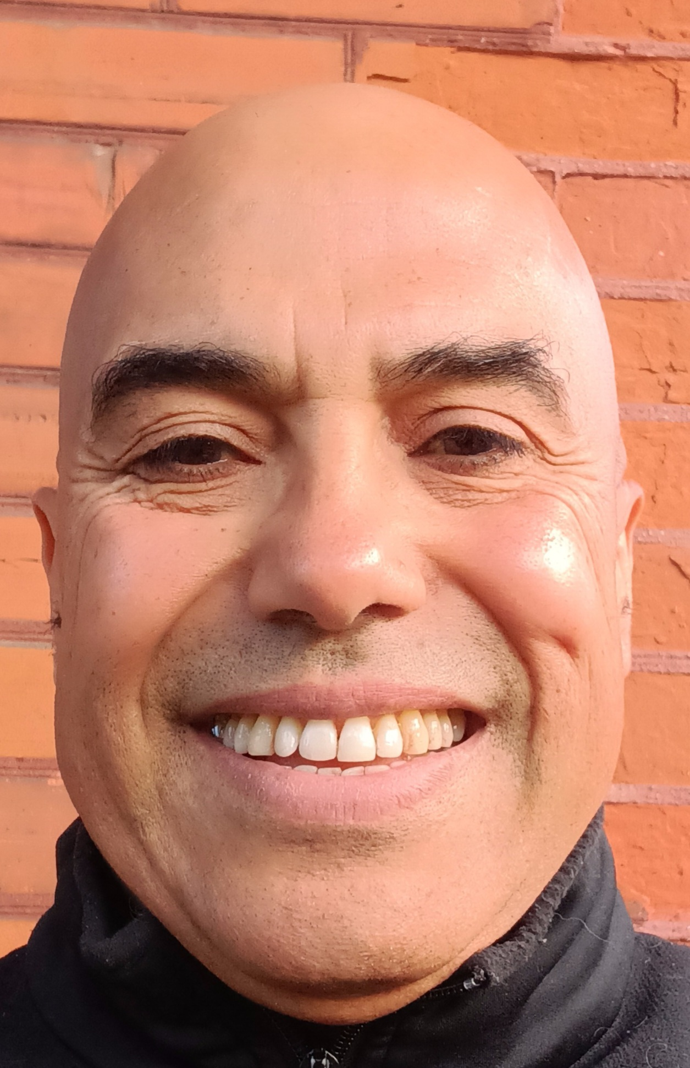


Religion and Culture Colloquium
North African Deportees and the Birth of New Caledonia as a Penal Colony
December 10, 2025, 12:30 p.m. – 2:00 p.m., Schlegel Building 107
Dr. Abderrahman Beggar is a professor in the Department of Religion and Culture at Wilfrid Laurier University and a fellow at the Tshepo Institute for the Study of Contemporary Africa. He is currently conducting a SSHRC-funded research project titled “The New Caledonian Arabs in Bourail and Nessadiou and the Birth of the Penal Colony: Life Stories and Social Ghosts.”

